Slide 1
Introduction to Machine Learning
Session 3
For TUM PhD students
Claudia Serrano Colome
claudiaserranocolome@gmail.com

Slide 2

Github
Navigate to https://github.com/cserranocolome/ml_course_intro
Download the materials for the session

Slide 3

Anaconda Navigator
Start Anaconda Navigator and click on Launch under the jupyter notebook tool

Slide 4
Recap from last session
Supervised Learning concepts
Regression algorithms
Linear Regression
Multiple Linear Regression
Beyond Linear Regression
Common pitfalls
Classification algorithms
Logistic Regression
k-Nearest Neighbors
Decision Trees
The Learning Process - Loss function

Slide 5
Today's session outlook
Unsupervised Learning concepts
Dimensionality Reduction
PCA
t-SNE
UMAP
Clustering methods
Distance Metrics
k-Means Algorithm
Choosing Number of Clusters (k)
Hierarchical Clustering

Slide 6
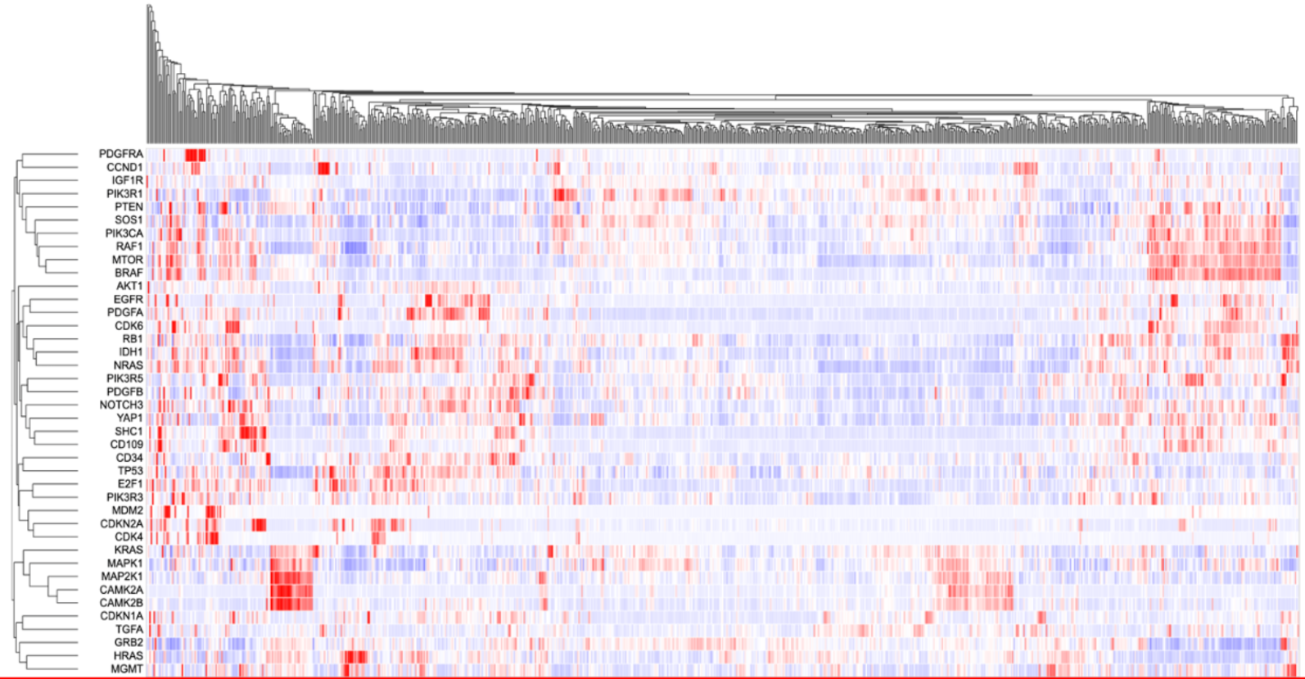
What is Unsupervised Learning?
Source: https://docs.gdc.cancer.gov/Data_Portal/Users_Guide/gene_expression_clustering/
Algorithms that find hidden structure or groupings in unlabeled data.
No target “y”, only features “X”.
Examples:
Grouping genes by expression
Clustering similar materials
Reducing dimensions

Slide 7
Comparison: Supervised vs Unsupervised
 | Supervised | Unsupervised
Data | Labeled | Unlabeled
Goal | Predict Target | Discover Structure
Output | Predictions | Clusters / Components
Example | Predict expression of a gene Classify tumor type | Group genes by expression Reduce dimensions to visualize

Slide 8
Why Unsupervised Learning?
Explore unknown datasets
Detect patterns, outliers, subgroups
Simplify complex data for interpretation
Support hypothesis generation in research
Unsupervised learning is often the first step before applying supervised methods.

Slide 9
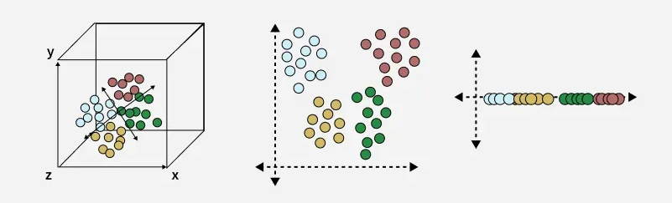
Introduction to Dimensionality Reduction
Many datasets have dozens/hundreds of features → hard to visualize and model
Dimensionality reduction simplifies the feature space while preserving structure
Benefits: visualization, noise reduction, speed and interpretability
Source: https://www.geeksforgeeks.org/machine-learning/dimensionality-reduction/

Slide 10
Common Algorithms for Dimensionality Reduction
Linear approach
Principal Component Analysis (PCA)
Non-linear approaches
t-SNE
UMAP

Slide 11
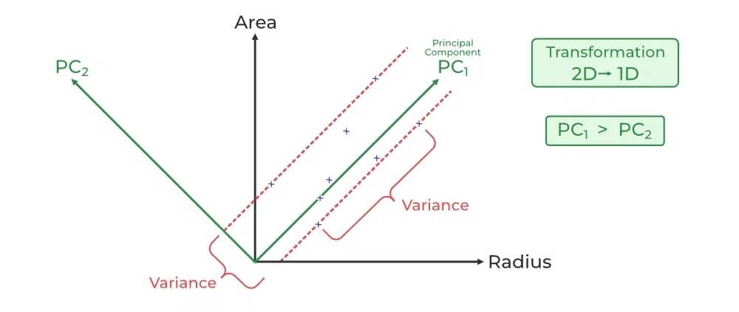
Principal Component Analysis (PCA)
Uses linear algebra to transform data into new features called principal components.
It finds these calculating eigenvectors (directions) and eigenvalues (importance) from the covariance matrix.
Intuition: find the directions where the data varies the most (useful information)

Slide 12
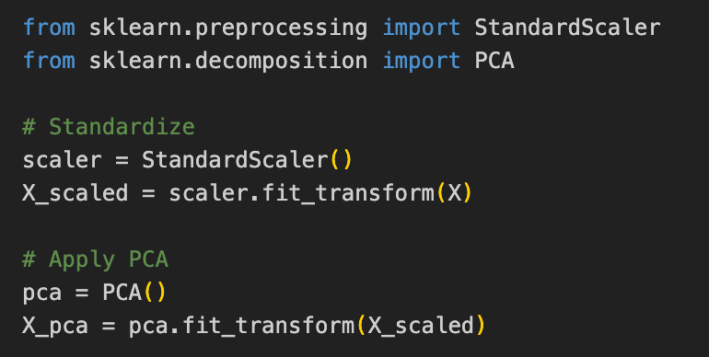
Principal Component Analysis (PCA)
We can extract useful information from the pca object:
pca.components_
pca.explained_variance_ratio_

Slide 13
t-SNE and UMAP
t-SNE:
Designed to preserve the local structure of data, making them good for visualizing complex datasets.
It works by minimizing the divergence between two distributions: a distribution that measures pairwise similarities in the high-dimensional space and a similar distribution in the low-dimensional space.
UMAP:
Focus on preserving both local and global structure of the data.
It works by constructing a high-dimensional graph of the data and then optimizing a low-dimensional graph to be as structurally similar as possible.

Slide 14
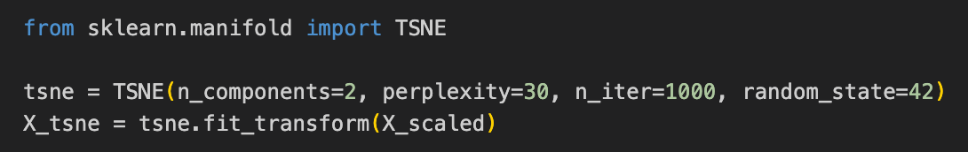
t-SNE
t-distributed Stochastic Neighbor Embedding
Perplexity: hyperparameter that controls the balance between preserving local and global data structures by setting the effective number of nearest neighbors for each data point.
Typical values range from 5 to 50.

Slide 15
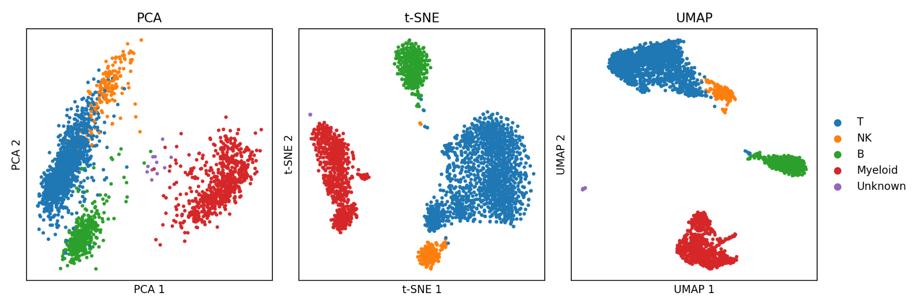
PCA vs t-SNE vs UMAP
Source: https://mbernste.github.io/posts/dim_reduc/
Notes:
Unfortunately, because it is mathematically impossible to avoid losing information when mapping data from high to low dimensions, these algorithms inevitably lose some aspect of the data, either by distortion or ommision, when plotting it in lower dimensions. This limitation makes the figures generated by these methods easy to misinterpret. Because of this, dimensionality reduction algorithms, especially t-SNE and UMAP, are facing new scrutiny by those who argue that nonlinear dimension reduction algorithms distort the data so heavily that their output is at best useless and at worst harmful. On the other hand, proponents of these methods argue that although distortion is inevitable, these methods can and do reveal aspects of the data’s structure that would be difficult to convey by other means.

Slide 16
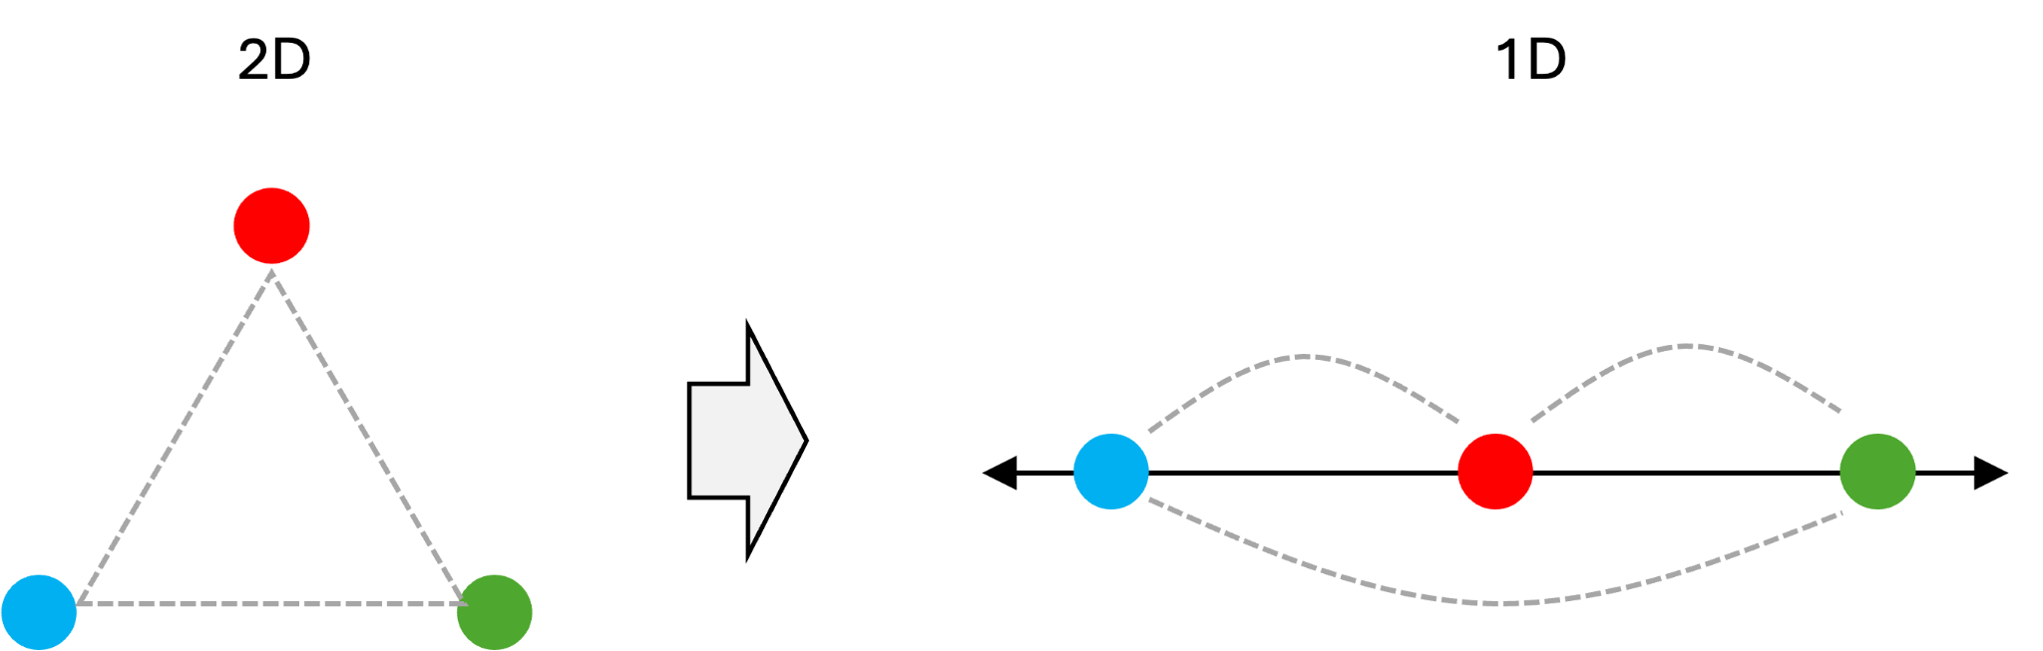
Important considerations
When applying dimensionality reduction, we inevitably lose information.
One important loss: distances.
It is not possible to compress data down to a lower dimension and preserve all relative pairwise distances.

Slide 17
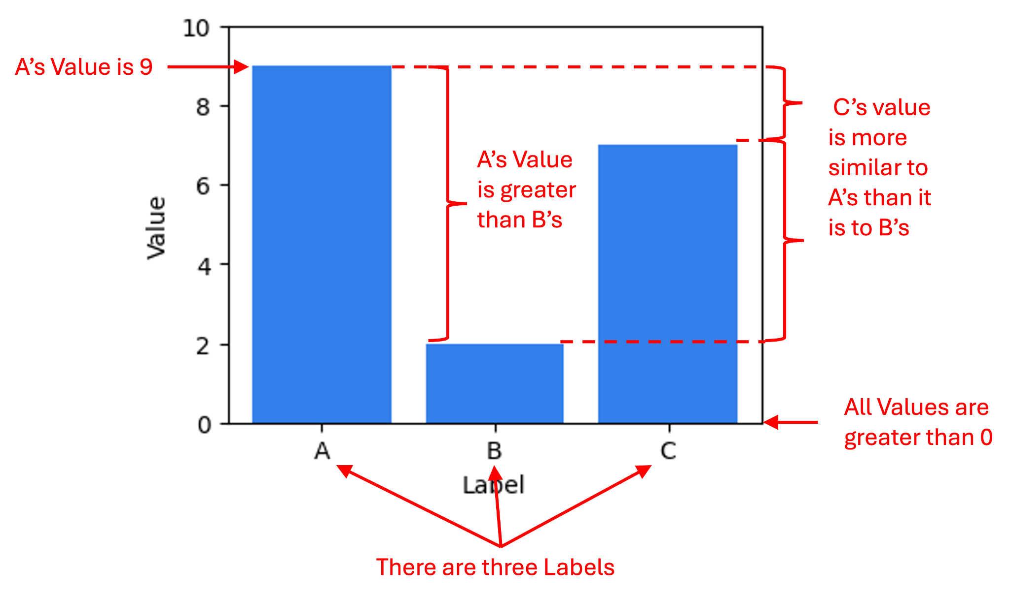
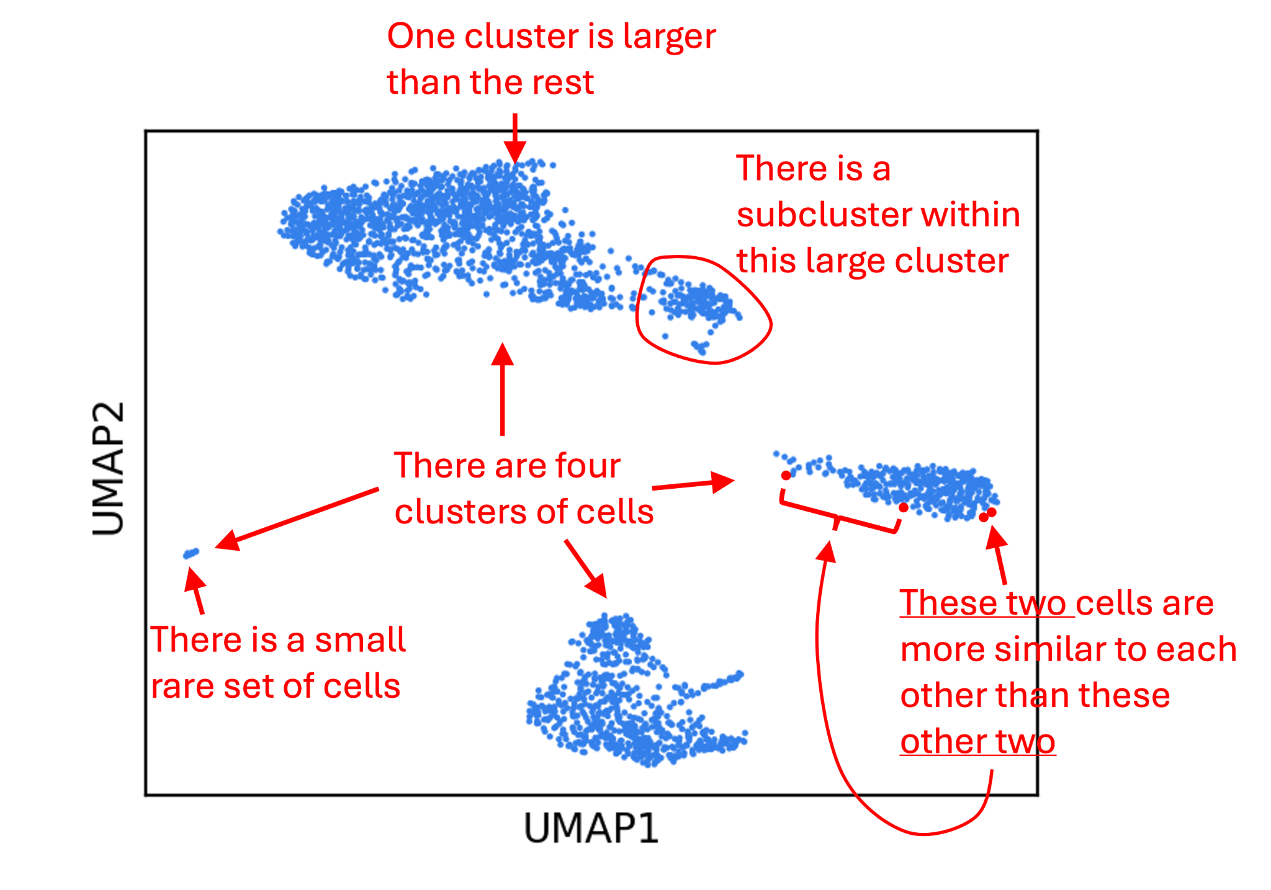
Important considerations
Differences between classical plotting of the data and dimensionality reduction:
Correct statements Possibly incorrect statements
Notes:
Specifically, for dimensionality reduction plots, the statements one might draw from them about the data may be wrong. Said differently, dimensionality reduction plots help users draw uncertain inferences about the structure of the data whereas there is no uncertainty in a traditional data visualization.

Slide 18
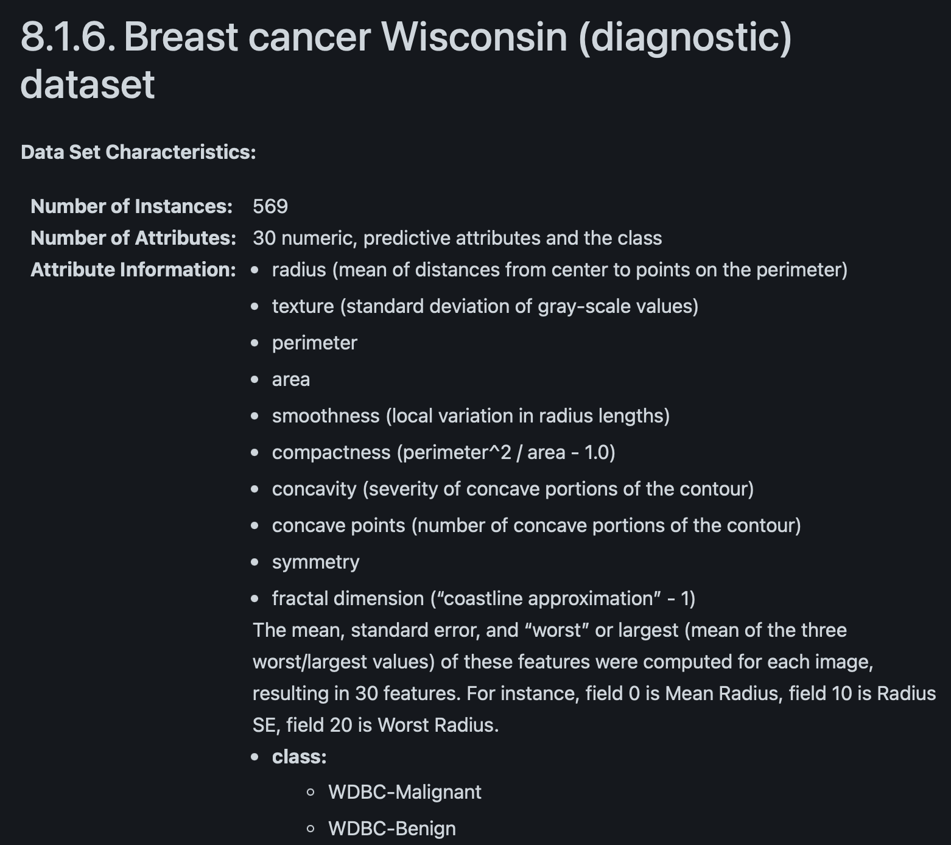
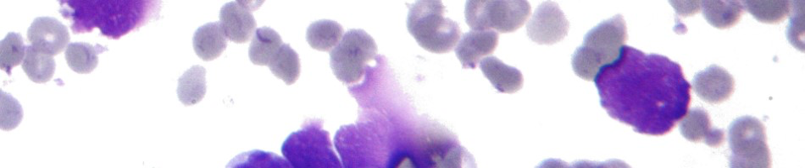
Breast Cancer Dataset
https://scikit-learn.org/stable/datasets/toy_dataset.html
We are going to reuse it, ignoring the labels and keeping them only for evaluation.

Slide 19
Hands On

Slide 20
Break

Slide 21
Introduction to Clustering
Grouping data points so that those within a cluster are more similar to each other than to points in other clusters.

Slide 22
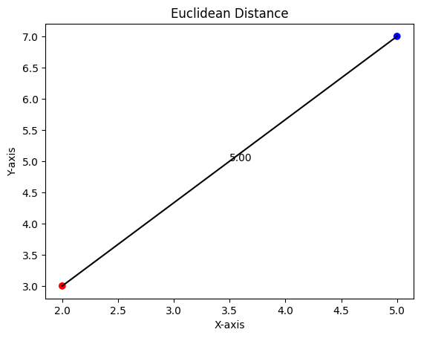
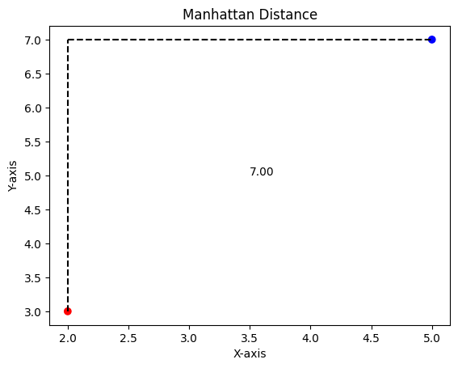
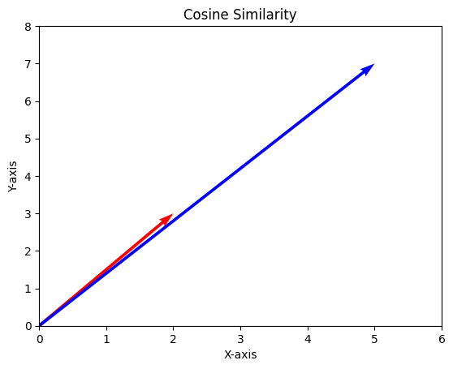
Distance Metrics
Source: https://www.geeksforgeeks.org/machine-learning/clustering-distance-measures/
Foundation of clustering = similarity or distance
Common metrics:
Euclidean (continuous)
Manhattan
Cosine similarity (vectors)

Slide 23
Common Algorithms for Clustering
Hard Clustering: each data point strictly belongs to exactly one cluster.
Soft Clustering: assigns each data point a probability or degree of membership to multiple clusters simultaneously.
Types:
Centroid-based Clustering
k-Means Algorithm
Connectivity-based Clustering:
Hierarchical Clustering
Density-based Clustering
Distribution-based Clustering

Slide 24
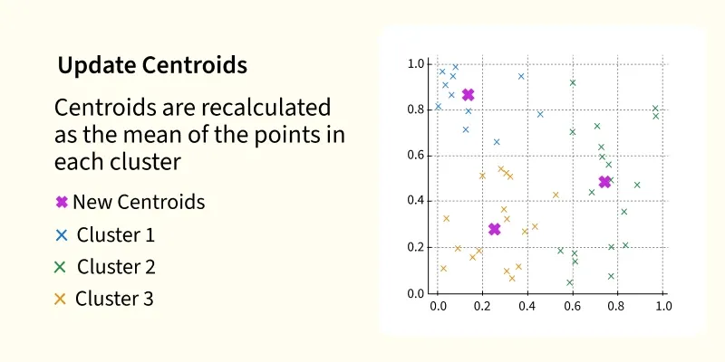
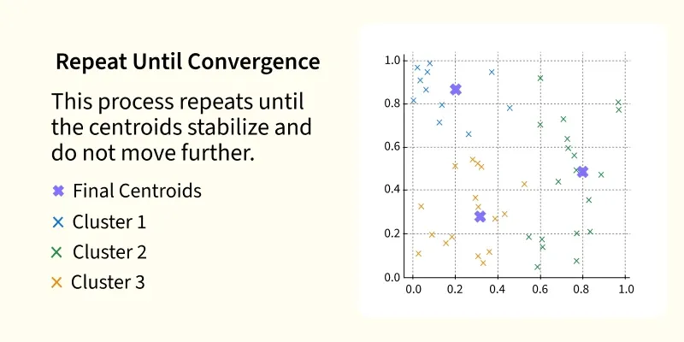
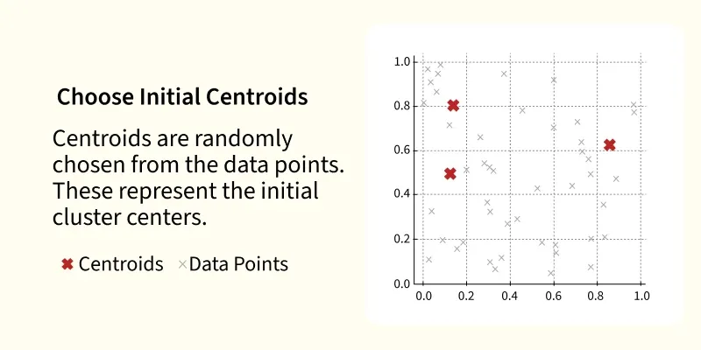
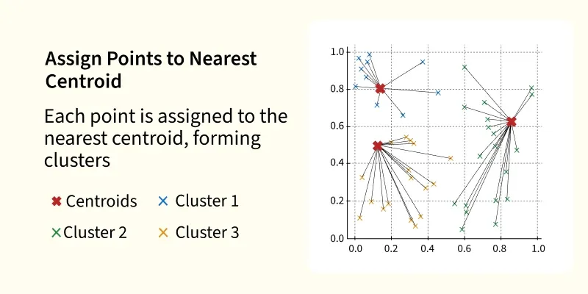
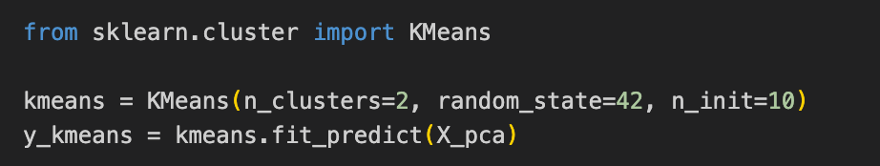
k-Means Algorithm
k = 2
Hard clustering, centroid based.
Steps:
Choose k number of clusters
Randomly initialize centroids
Assign each point to nearest centroid
Recalculate centroids
Repeat
Source: https://www.geeksforgeeks.org/machine-learning/k-means-clustering-introduction/

Slide 25
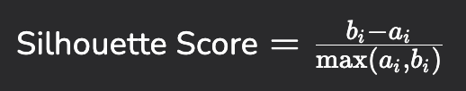
Metrics to Quantify Cluster Quality
The Silhouette Score evaluates how well each data point fits within its assigned cluster, and how distinctly separated it is from other clusters. For each data point, two main quantities are calculated:
Intra-cluster distance (a_i): This measures how close the data point is to other points within the same cluster.
It is computed by taking the average distance between the point and all other points in its own cluster.
A smaller value of a_i indicates that the data point is well-matched to its cluster.
Nearest-cluster distance (b_i): how far the data point is from points in the nearest neighboring cluster.
It is calculated as the average distance between the point and all points in the nearest different cluster.
A larger b_i means the data point is well-separated from neighboring clusters.
This difference between distances is turned into a score between -1 and 1 using the silhouette formula:

Slide 26
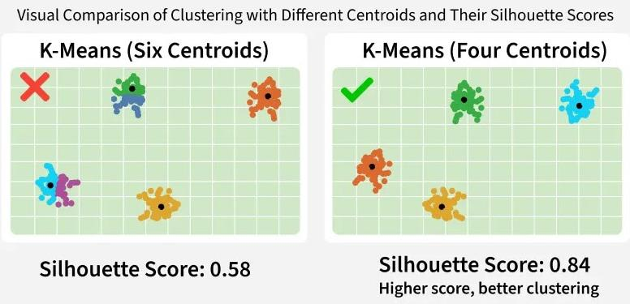
Metrics to Quantify Cluster Quality

Slide 27
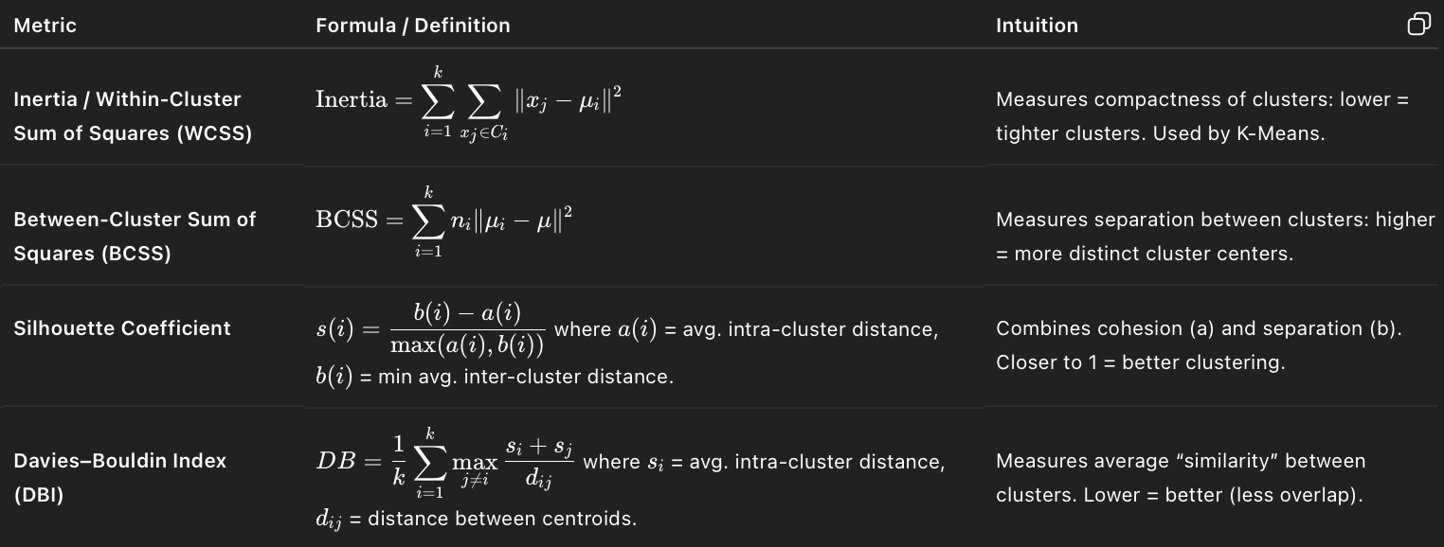
Metrics to Quantify Cluster Quality

Slide 28
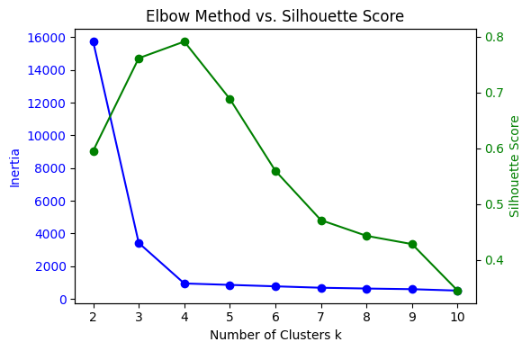
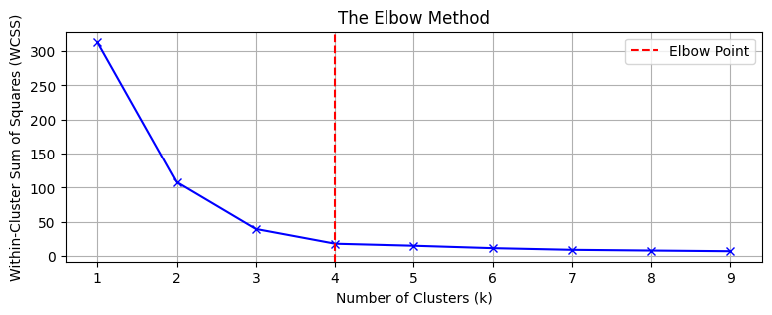
Choosing Number of Clusters (k)
The Elbow Method (plot within-cluster sum of squares)
Silhouette Score (cluster separation)
Domain knowledge also important

Slide 29
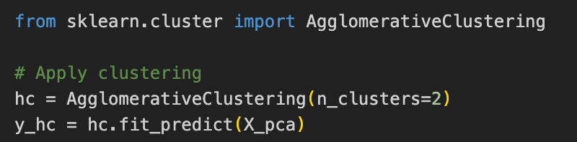
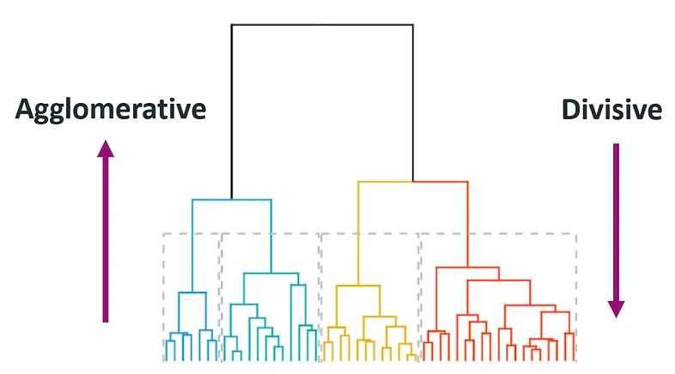
Hierarchical Clustering
Builds a tree of clusters (dendrogram)
Agglomerative (bottom-up): starts with individual data points as separate clusters and merges them into larger clusters based on similarity
Divisive (top-down):
starts with a single cluster and divides it into smaller ones
Source: https://www.linkedin.com/pulse/hierarchical-clustering-comprehensive-guide-understanding-massimo-re-r73gf/

Slide 30
Hierarchical Clustering
Example of distance calculation:
A(2,3)
B(5,4)
C(9,7)
D(8,2)
E(7,5)
C
E
B
A
D

Slide 31
Hierarchical Clustering
Example of distance calculation:
A(2,3)
B(5,4)
C(9,7)
D(8,2)
E(7,5)
Pairwise Euclidean Distance
 | A | B | C | D | E
A | 0 | 3.16 | 8.06 | 6.08 | 5.39
B | 3.16 | 0 | 5.00 | 3.61 | 2.24
C | 8.06 | 5.00 | 0 | 5.10 | 2.83
D | 6.08 | 3.61 | 5.10 | 0 | 3.16
E | 5.39 | 2.24 | 2.83 | 3.16 | 0
Merge the closest clusters based on minimum distance:
B and E merge to {B,E}

Slide 32
Combining Clustering with PCA
Often use PCA to reduce dimensionality → then apply clustering
It is hard to interpret clusters in large dimensions, so typically it is performed in two dimensions. Therefore, we need to reduce the dimensionality first.
Var1 | Var2 | … | VarN
0.3 | -1.6 | … | 0.8
… | … | … | …
PC2
PC2
PC1
PC1
Initial Large Dimensional Data
Dimensionality Reduction
Clustering

Slide 33
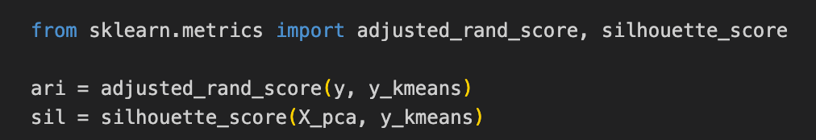
Evaluating Unsupervised Models
No labels → harder to measure “accuracy”
Options:
Internal metrics: silhouette score, Davies-Bouldin index
External (if labels exist later): adjusted Rand index
Visual inspection & domain validation
“Does this pattern make sense in your domain?”

Slide 34
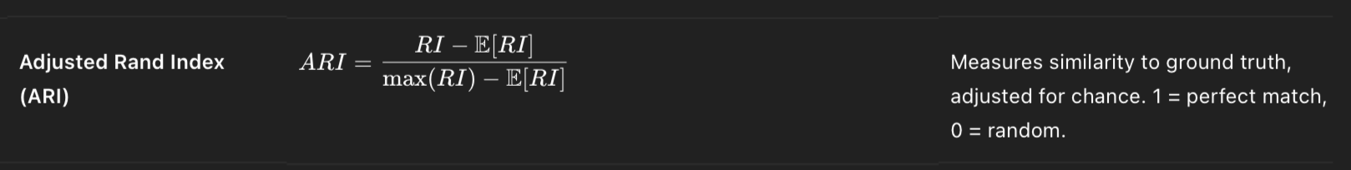
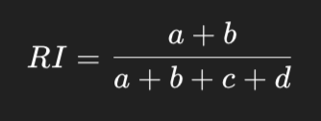
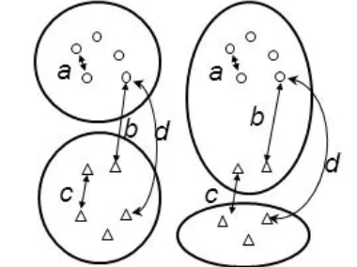
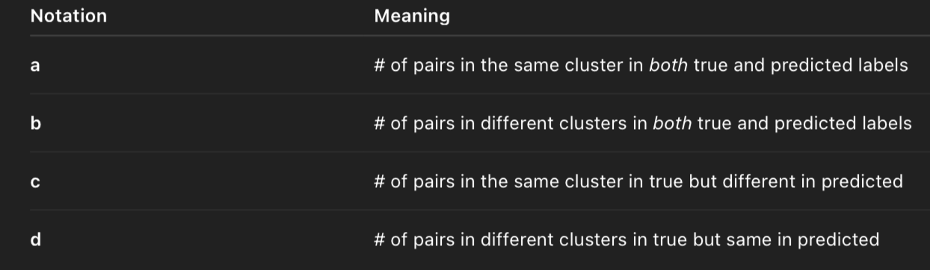
Adjusted Rand Index (ARI)
True - Predicted

Slide 35
Common Pitfalls
Arbitrary choice of k.
Sensitivity to scaling and initialization.
Clusters may not correspond to meaningful structures.
PCA interpretation can be misleading.

Slide 36
Hands On

Slide 37
Additional resources
Clustering Distance Measures
https://www.geeksforgeeks.org/machine-learning/clustering-distance-measures/
Clustering
https://www.geeksforgeeks.org/machine-learning/clustering-in-machine-learning/
https://www.geeksforgeeks.org/machine-learning/k-means-clustering-introduction/
https://www.geeksforgeeks.org/machine-learning/agglomerative-methods-in-machine-learning/
Dimensionality Reduction
https://www.geeksforgeeks.org/machine-learning/dimensionality-reduction/
https://www.geeksforgeeks.org/data-analysis/principal-component-analysis-pca/
Evaluation Metrics
https://medium.com/@anushka.datascoop/evaluation-metrics-in-machine-learning-101-accc3cd35af9

